Slide 1
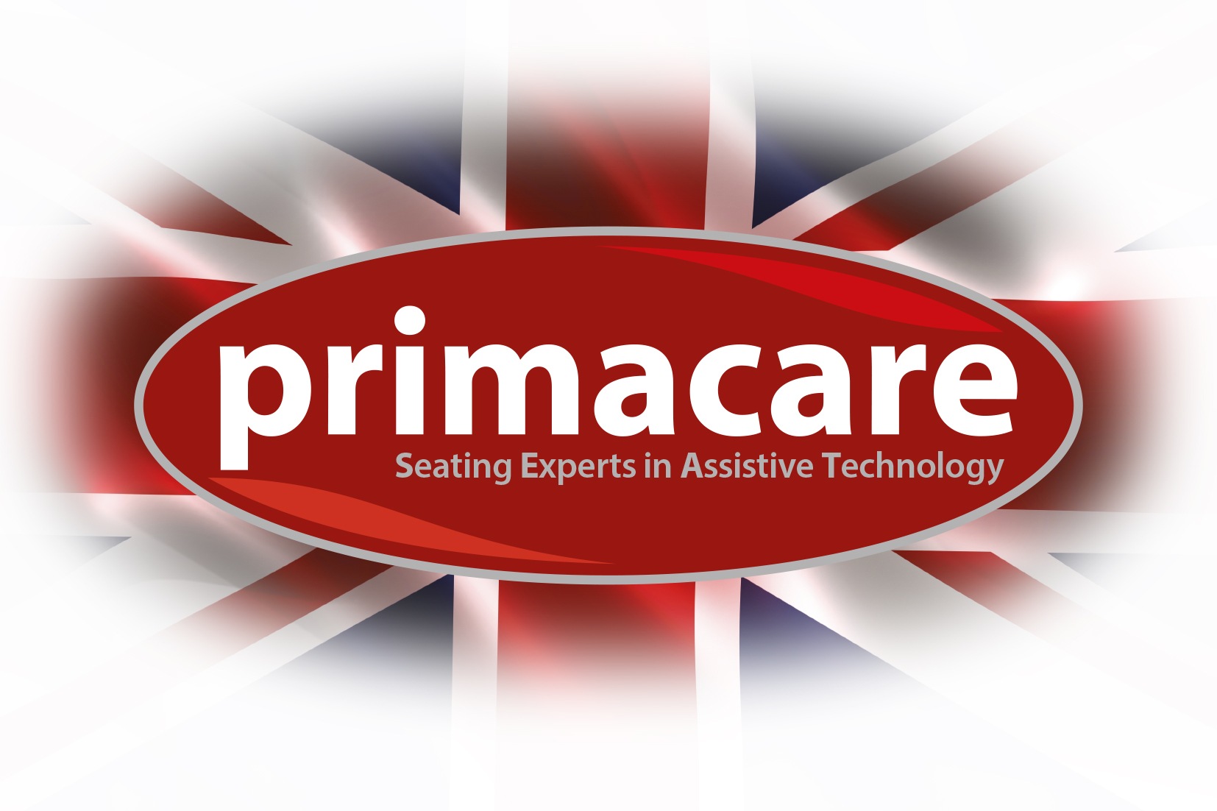
Our Background
The Care Team has been working in the Manchester, Liverpool and Cheshire area for over twenty-five years, providing unique, expert Occupational Therapy advice and products on mobility, seating, bathing and stair solutions.
The Chair Doctor is part of The Care Team service and has been developed over a number of years to help you get the most out of the chair that is so important to the comfort and medical needs of you or your client.
As dealers for most of the major suppliers, our work is backed by using authorised parts from manufacturers like Kirton, Primacare, AJ Way, Repose, Careflex & Tente

Slide 2
